Slide 1
Introduction to
Unified Modelling Language (UML)

Slide 2
Unified Modelling Language (UML)
Used in Software Architecture to represent class layout
Defines classes, methods, parameters
Right now: very minimal
We will use it to:
Provide an overview / picture of the classes
Help you visually see the program
Give you a tool to ‘draw out’ a class
This class does not go into the theory on program layout
Just introducing

Slide 3
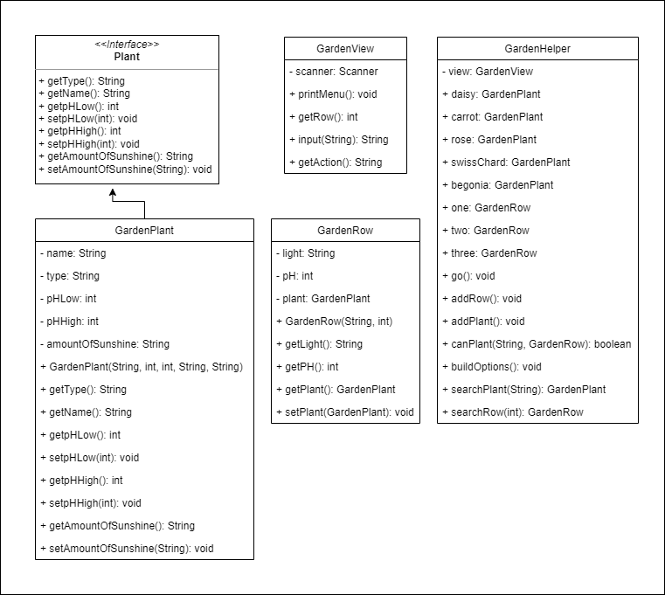
Lab Example
+ means public
means private
Format:
Name : Type
canPlant(String, GardenRow): boolean
Method
Takes in two parameters
String
GardenRow
Notice identifiers are not there, it is up to you
returns a boolean value
Instance Variables
Methods

Slide 4
UML General Rule
It is a tool
One of many
Meant to help you get a visual idea of what to work on
Not helpful for everyone
Will have some ‘drawing out the uml’
Just more so you can draw out the class information
We will come back to this later with inheritance

